Slide 1

Bartesaghi Andrea 928656
Bersani Federico 926343
Gupta Pragati 938654
Khan Mohsin 943115
Palombini Elena 945573
Vigoni Silvia Francesca 921181
Vitali Camilla 920935
SONIK
Digital Business Innovation Lab
a.y. 2019/2020

Slide 2

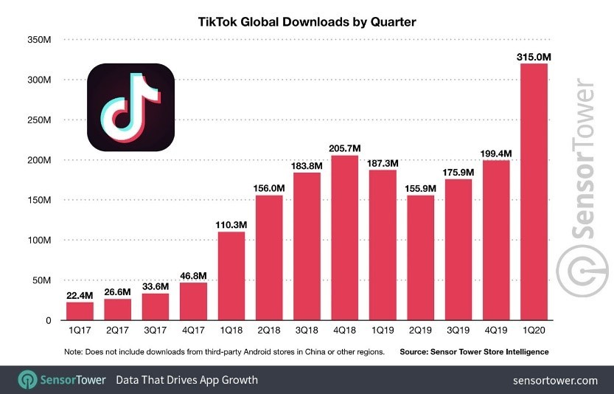
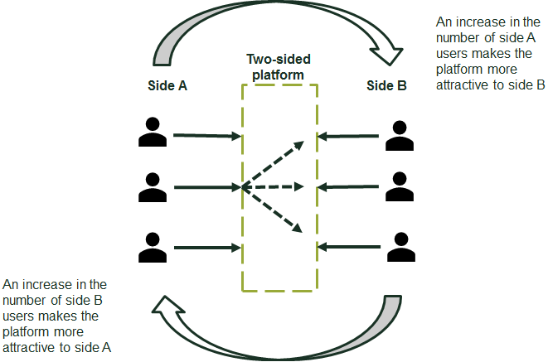

Introduction
KEY FEATURES
Tremendous exponential growth
Leverages on existing technologies
Provides a new unique value
BIG BANG DISRUPTION
Strong impact on the music industry
Highly dynamic environment
Enormous amount of data generated
1

Slide 3
Problem Setting
How can we find new artists and hits on this platform? It is too spread and we lack data!
How can we converge TikTok audience to the songs of our artists? We need a new strategy!
CUSTOMER PAINS
High marketing effort (Marketing function)
Missing emerging artists (A&R function)
Lack of data
Unfamiliar and fast environment
Little control on the platform
Claudia, A&R function’s employee at Sony Music
Luca, Marketing function’s employee at Sony Music
2

Slide 4




Vision, Mission, Purpose and Analysis
Vision
Exploit the power of digital technologies as a “geyser” able to push the company on a higher level and to get the best from the music landscape’s evolutions.
RENEWAL
STRENGTHS
WEAKNESSES
High-level quality of A&R department
Diversification of business Advanced data analytics
multichannels
Extensive expertise in marketing
High R&D
Partnership networks
Mission
Be the best and the first in discovering new viral artists. Engage with the artists, suggesting always new and innovative ways to rapidly and broadly promote their songs, to transmit their personality and to put them closer to customers.
Difficulties in discovering and evaluating emergent artists
Lack of scouting and marketing strategies
Low brand recognition
3
ADAPTIVE
SHAPING
OPPORTUNITIES
THREATS
UNPREDICTABILITY
Maintenance and control of solutions
Independent artists exploit by themselves new technologies
Dynamic and fast environment
High concentrated market
Streaming platforms exploitation
Real-time feedbacks thanks to social media
Broader potential fanbase
Power of AI and machine learning
Purpose
Create a structured and technological process to enhance the performances of the A&R and Marketing functions, adapting to the evolutions that are affecting the market.
CLASSICAL
VISIONARY
HARSHNESS
MALLEABILITY
3
Notes:
MAGARI POTREMMO METTERE PRIMA IN GRANDE VISION MISSION PURPOSE (CENTRALI) POI SI SPOSTANO VERSO L’ALTO E IN SEQUENZA ESCONO PEST, POI SWOT POI STRATEGY PALETTE

Slide 5







The Idea
UNIQUE VALUE PROPOSITION
“Anticipate competitors in spotting new talents in a dynamic and new environment and promote Sony's songs relying on an effective, efficient and differentiated marketing, based on predictive analysis and on a marketing framework that aims to engage the final users”
A&R and SCOUTING
MARKETING PROCESS
WEB SCRAPING
ALGORITHM
BADGE SYSTEM
WEB SCRAPING
ALGORITHM
SHORT-TERM CONTRACT
MARKETING
FRAMEWORK
DASHBOARD
DASHBOARD
4

Slide 6










Underlying Technologies
Scouting Algorithm works on the same basis of the marketing one, but the main difference is that it should receive in input clips of new songs published on TikTok.
The A&R department can scout emerging artists from the platform before they go to the top of the charts.
Marketing Algorithm makes it possible to optimize a specific part of the process of releasing songs to TikTok: the choice of the 30 seconds snippet.
Sony Song
Get Attributes (Feature Selection)
TikTok successful and unsuccessful Song
Model Creation
Successful and unsuccessful song →Spotify API
Score Prediction
Feature Selection
Model creation
Selected Audio Clip
5

Slide 7
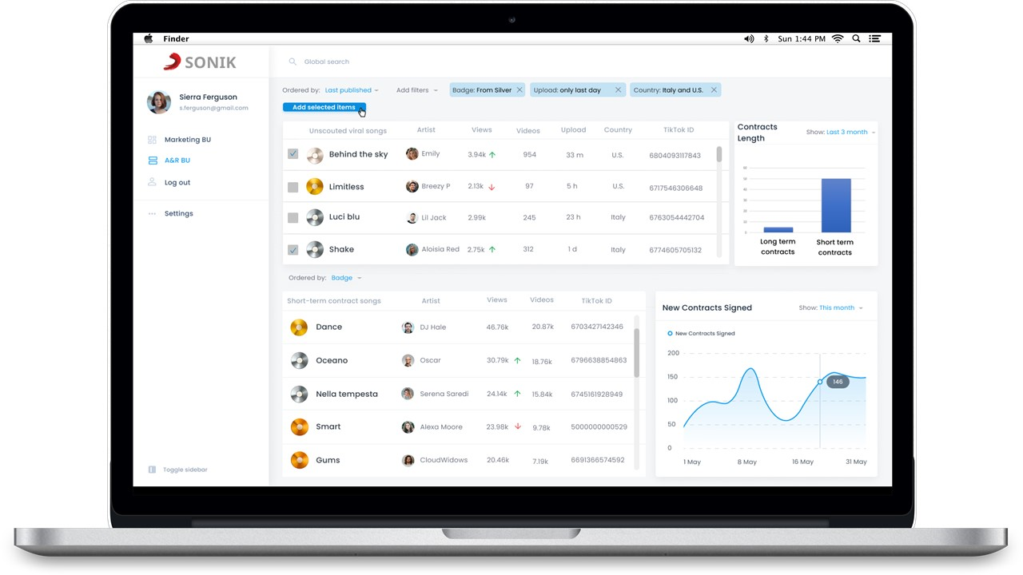
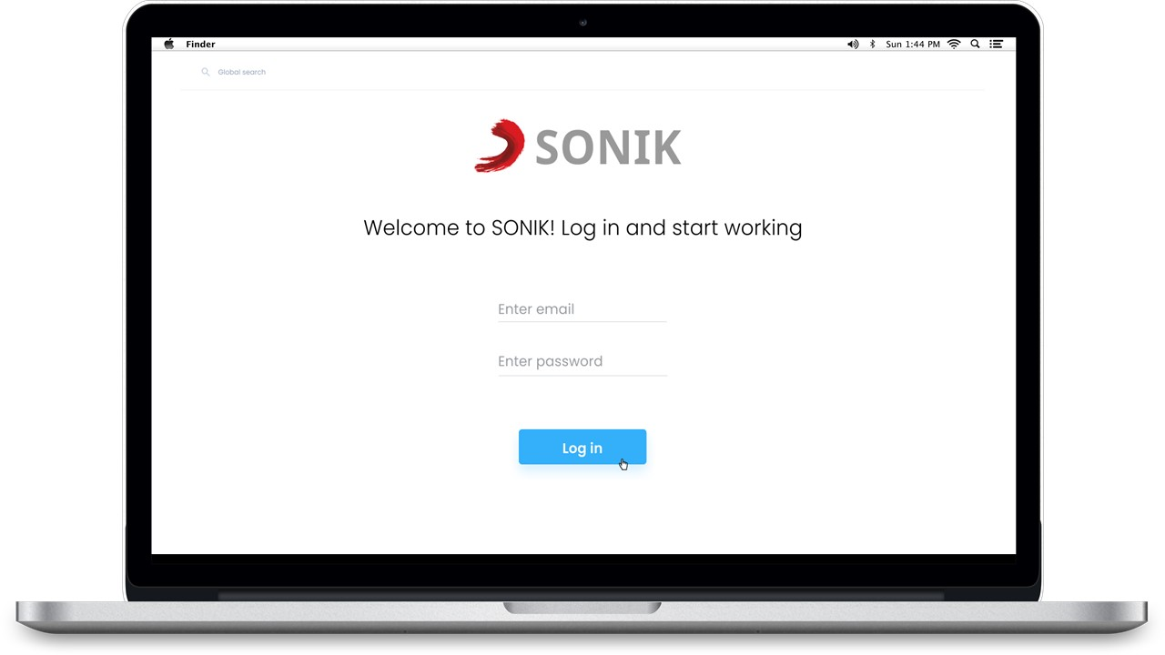
A&R Journey
ACCESS
OPEN SCOUTING SECTION
FILTER OPTIONS
ANALYSIS AND SELECTION
CONTACT AND DECISION
6

Slide 8
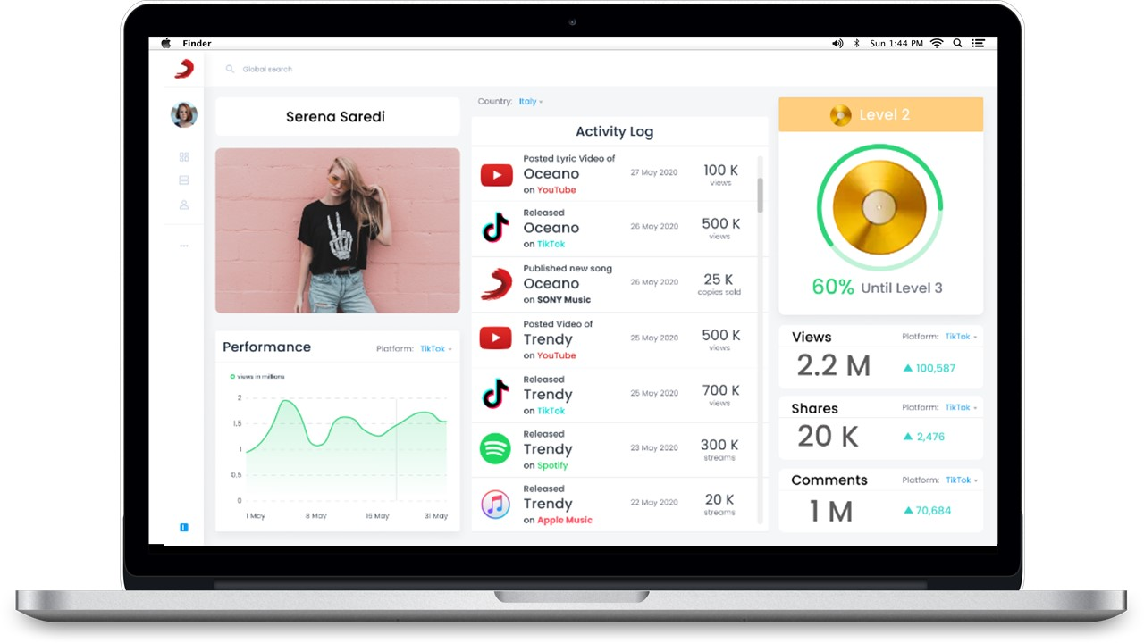
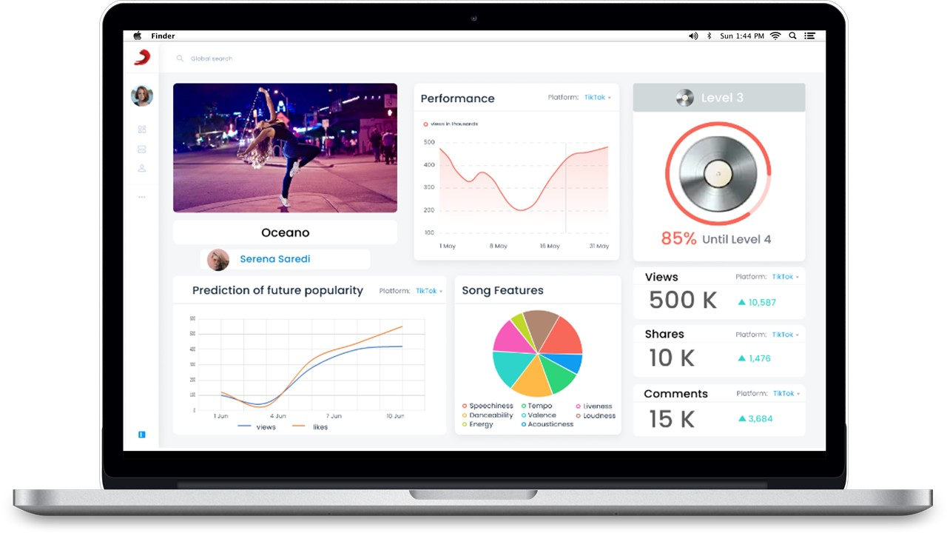
A&R Journey
SHORT TERM CONTRACT AND SUPPORT
MONITOR
LONG TERM CONTRACT
7

Slide 9
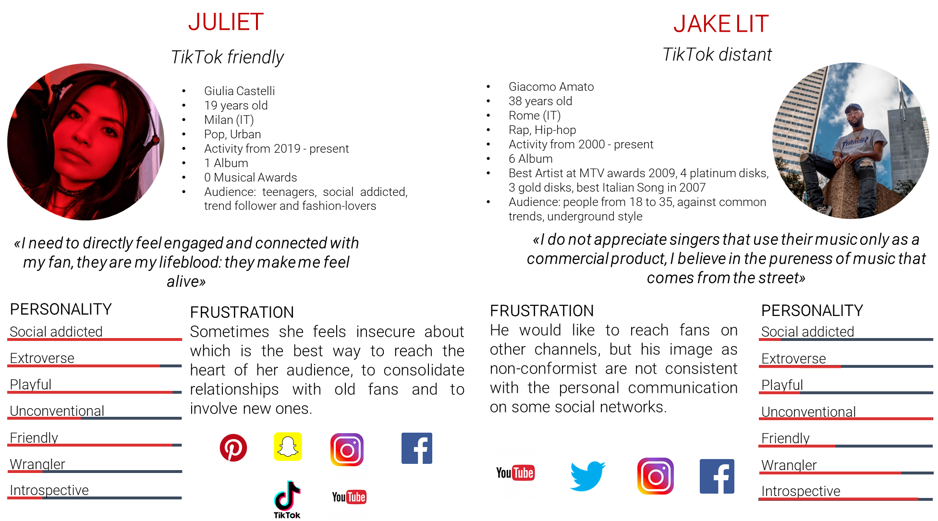
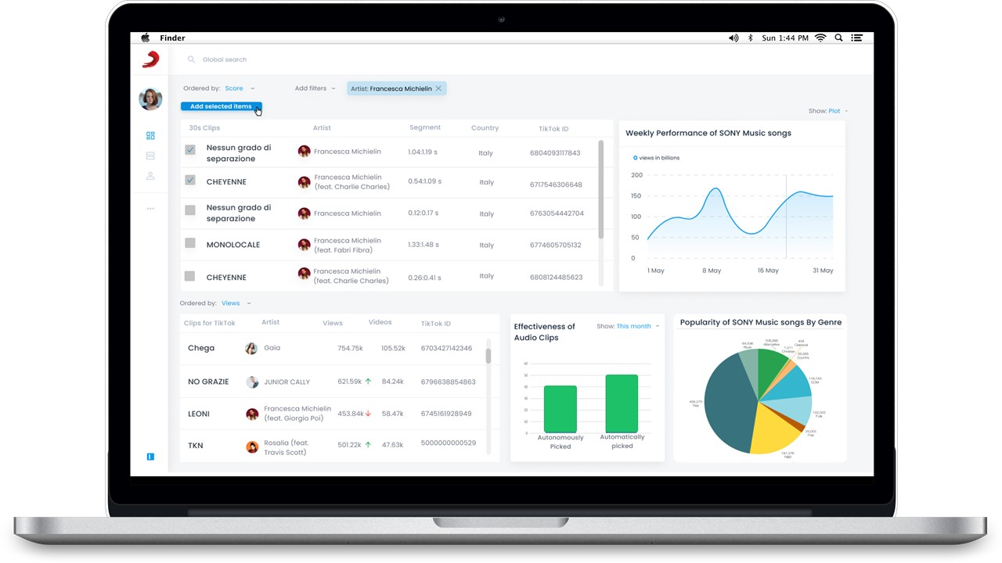
Marketing function Journey
ACCESS
OPEN MARKETING SECTION
FILTER OPTIONS
ANALYSIS AND SELECTION
CONTACT AND DECISION
EXECUTE MARKETING FRAMEWORK
MONITOR
8

Slide 10


Economic Perspective
TIKTOK USERS WITH A PAID SUBSCRIPTION
ADD TIKTOK TRACKS TO THEIR PLAYLISTS
USERS CONVERTED
NUMBER OF USERS CONVERTED
LISTENING TO SONY’S SONGS
63%
63%
?%
WORST CASE HYPOTHESES
MONETARY RESULTS
NON-QUANTIFIABLE RESULTS
€5
TikTok success is momentaneous: in the next years the number of TikTok users will decrease
Imitation or innovative solutions from competitors:
Number of users converted will decrease
The increase of Sony’s listening of users converted will slow down
Saving costs were not considered in the computation
NPV (million €)
million
AWARENESS OF SONY’S ARTISTS
KNOW-HOW
9

Slide 11
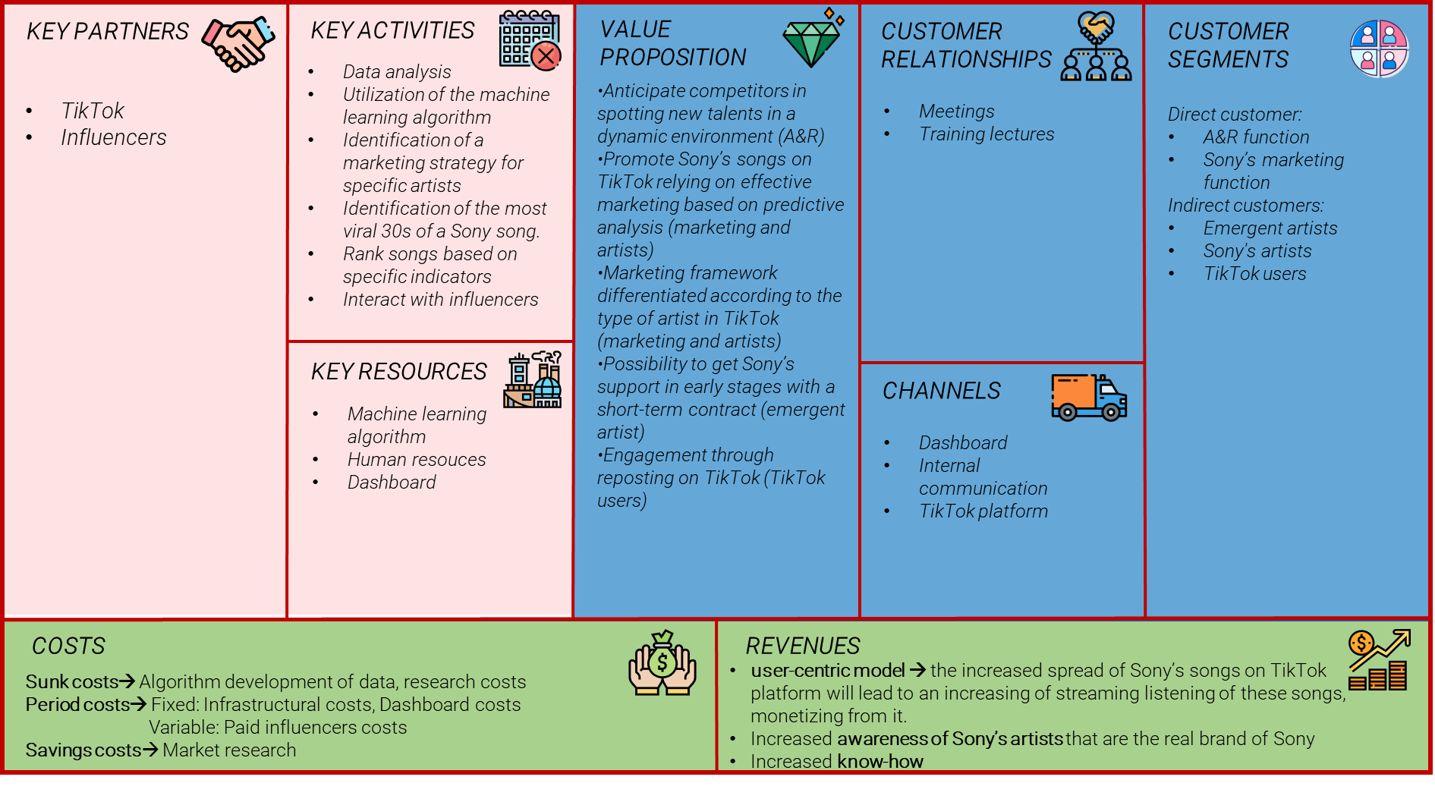
Validation
10

Slide 12










Validation
I HYPOTHESIS VALIDATION
II HYPOTHESIS VALIDATION
«TikTok users will actively participate to challenges proposed by artists, spreading Sony songs on TikTok.»
«TikTok platform helps in spreading tracks and in boosting the listening on streaming platforms.»
VALIDATION MODE:
SURVEY among TikTok users
VALIDATION MODE:
SURVEY
among TikTok users
DATA COMPARISON between TikTok and Spotify trends
(Sample of 167 respondents)
(Sample of 167 respondents)
CRITICAL
TEST COSTS
DATA RELIABILITY
TIME REQUIRED
CRITICAL
TEST COSTS
DATA RELIABILITY
TIME REQUIRED
47%
People adding TikTok songs to their playlist
People discovering new songs on TikTok
Most used streaming platforms
9%
23%
42%
26%
WOULD TAKE PART TO ARTISTS’ CHALLENGES
Users that take challenges and publish contents on TikTok
50 viral global
50 top global
50 viral Italy
50 top Italy
Users that take challenges and don’t publish contents on TikTok
Users that don’t take challenges and publish contents on TikTok
70%
84%
46%
52%
Users that don’t take challenges and don’t publish contents on TikTok
11

Slide 13

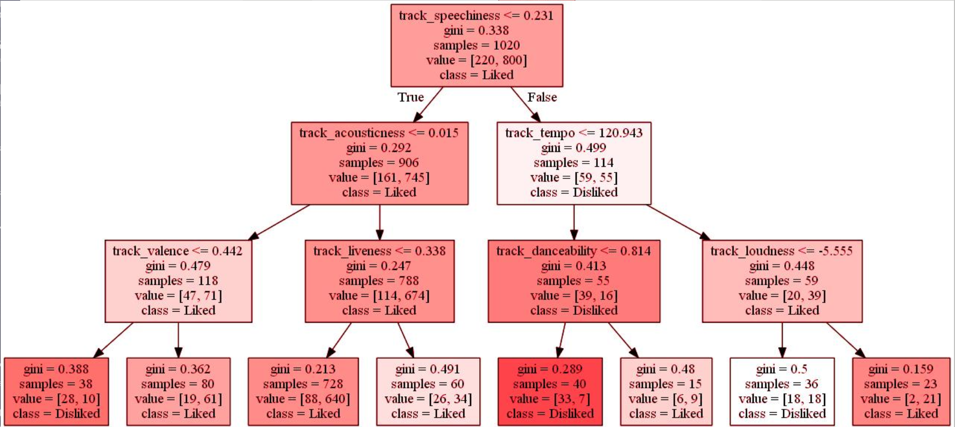
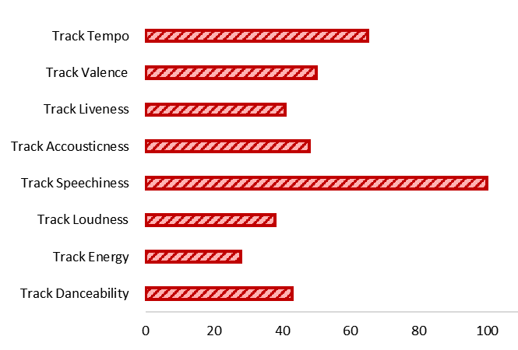
Validation
III HYPOTHESIS VALIDATION
«The marketing algorithm can extract the 30 most probable viral seconds from an existing song with a good accuracy.»
VALIDATION MODE:
CREATION OF AN MVP
Training and testing dataset composition
CRITICAL
TEST COSTS
DATA RELIABILITY
TIME REQUIRED
30%
Training dataset
Testing dataset
70%
Using decision tree methods, an accuracy between 80-85% can be achieved based on the tree depth.
12

Slide 14
Q&A

Slide 15
PEST Analysis
P
S
E
T
Social Netowork:
Increase in audience
Easier way to promote
TikTok Phenomenon
Copyright laws
GDPR for customers’ data treatment
Piracy
Streaming platform growth
Online streaming platform
AI and Machine Learning
1

Slide 16
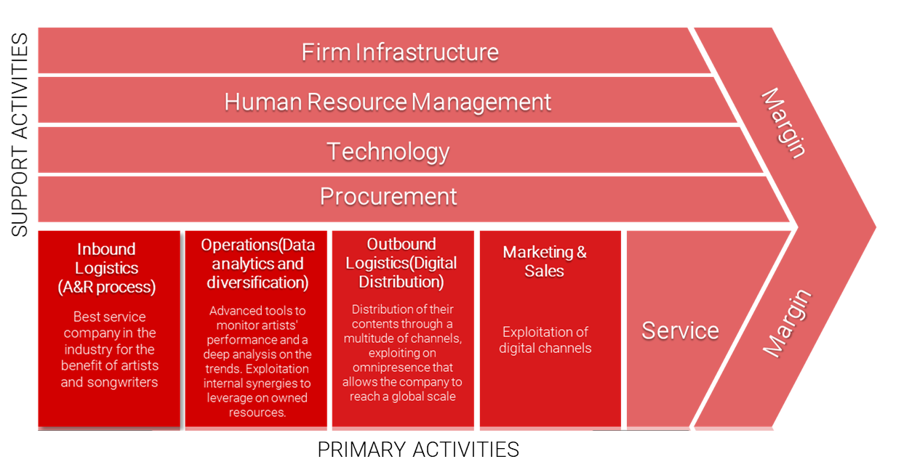
Porter’s Value Chain
2

Slide 17
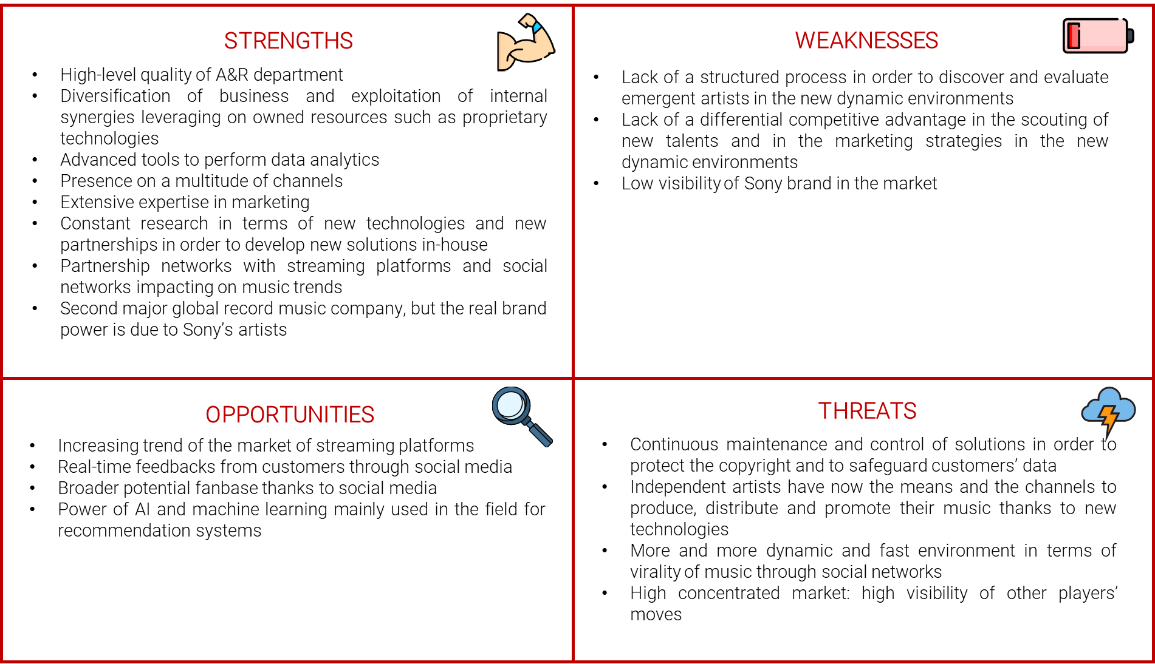
SWOT
3

Slide 18
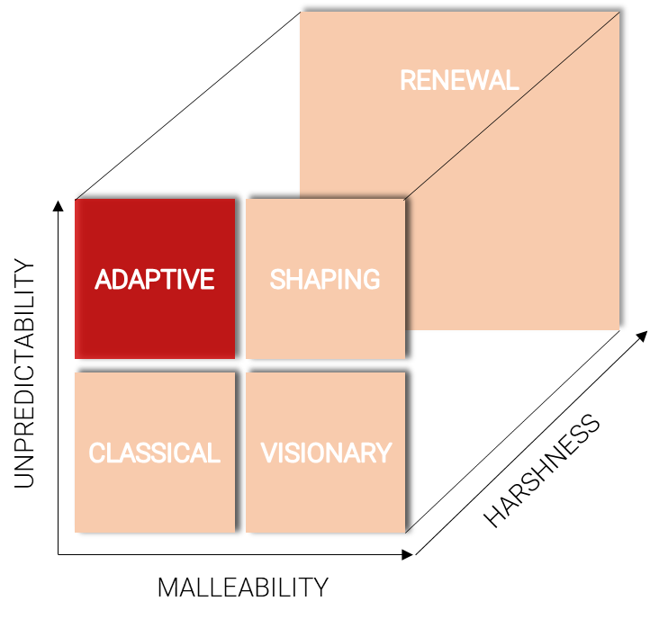
Strategy Palette
4

Slide 19
Strategic Posture
The turbulence in the music industry is low: the entry rate is not so high since the industry is dominated by few big players and to compete with them, knowledge of the processes, capital (financial, human, physical and intellectual) and a strong IT organization are needed.
The concentration is high, few majors are operating and dominating the market with 66.2% of the market share. The remaining 33.8% is managed by many small independent labels. The concentration is still increasing due to mergers and acquisitions: the last one concerns Sony Music Entertainment’s acquisition of EMI Music in 2018. Due to a high concentration, all the actions of the majors can be seen by competitors and easily imitated.
The growth of the demand is highly increasing, as emerged from the economic trends in the PEST analysis, mainly due to streaming channels. The market is based on new content creation and, since the product sold is music, the demand for it will hardly decrease. On the contrary, it will be always higher thanks to the global accessibility to music, enabled by streaming platforms and by the customers who are always “hungry” of new music.
The companies inside the industry should apply a strategy that is coherent with what other players are doing, without differentiating and diverging from industry norms. Therefore, competitors will tend to imitate each other, and this is the confirmation that a key differentiating factor in this environment is something that cannot be visible to the other firms.
5

Slide 20
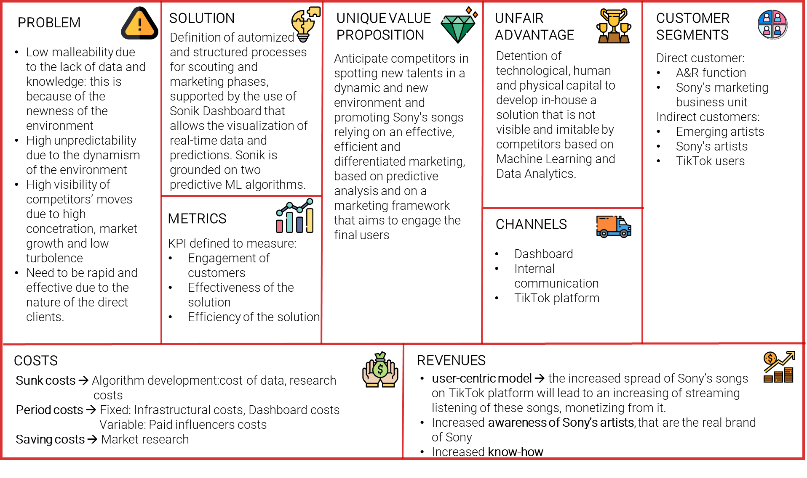
Lean Canvas
6

Slide 21
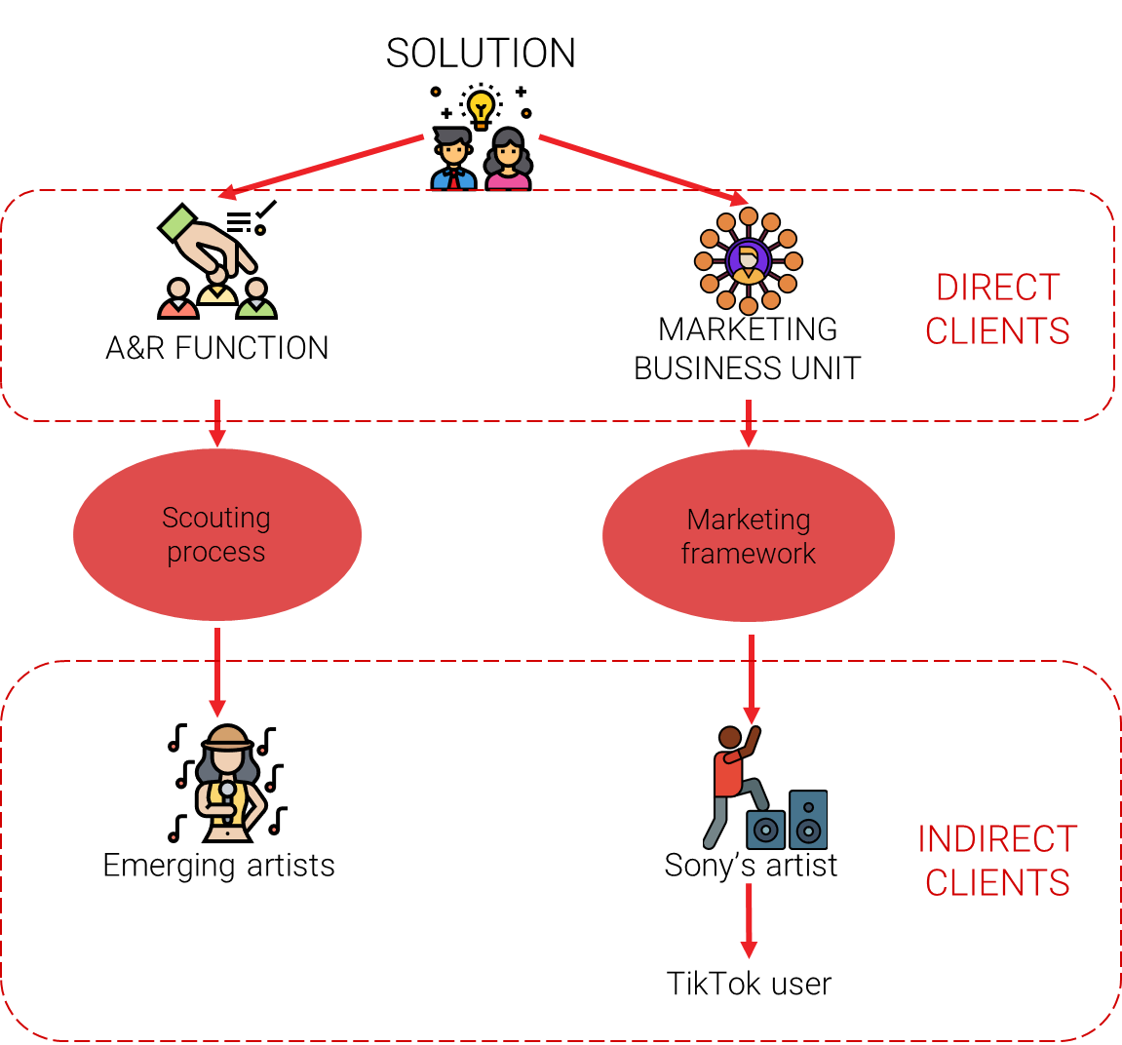
Customer Segments
7

Slide 22
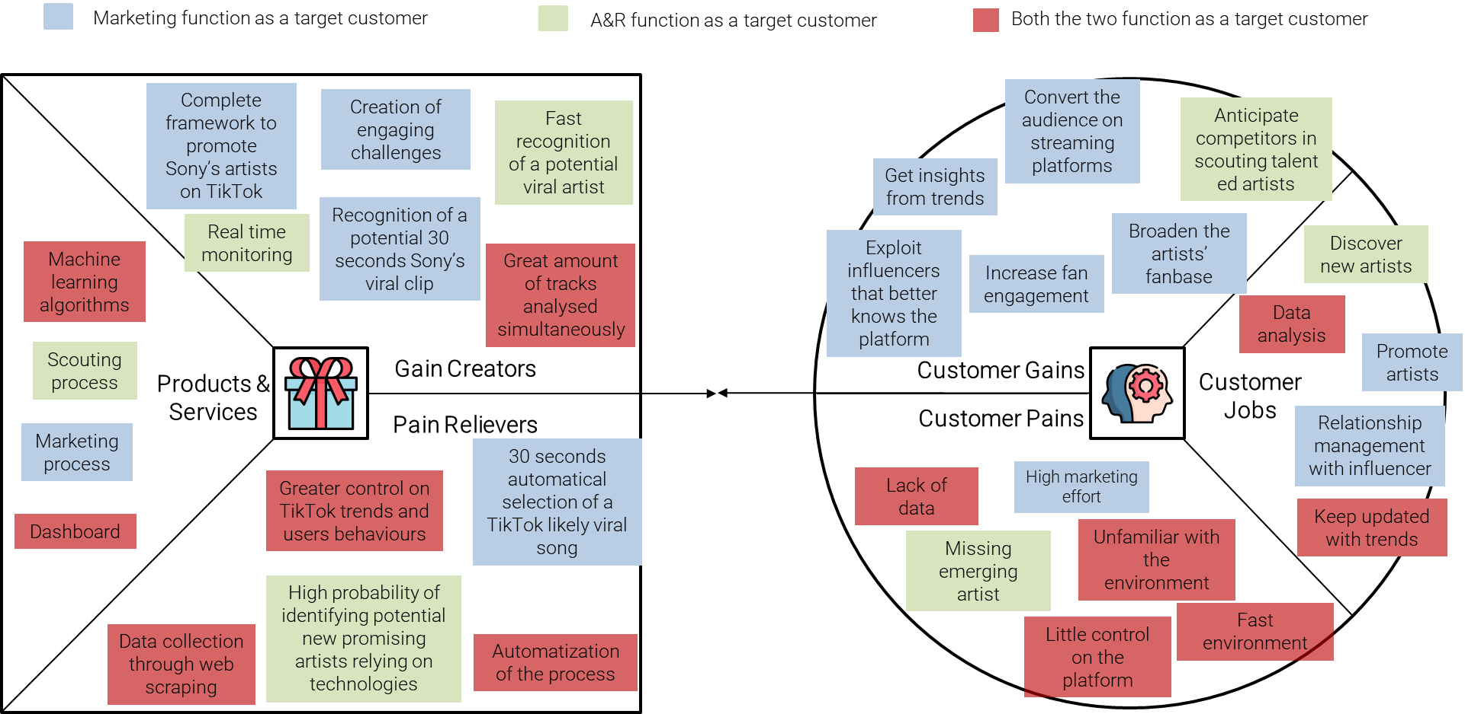
Value Proposition Canvas
8

Slide 23
Dashboard: Welcome Page
9

Slide 24
Dashboard: Scouting Page
10

Slide 25
Dashboard: Artist Page
11

Slide 26
Dashboard: Song Page
12

Slide 27
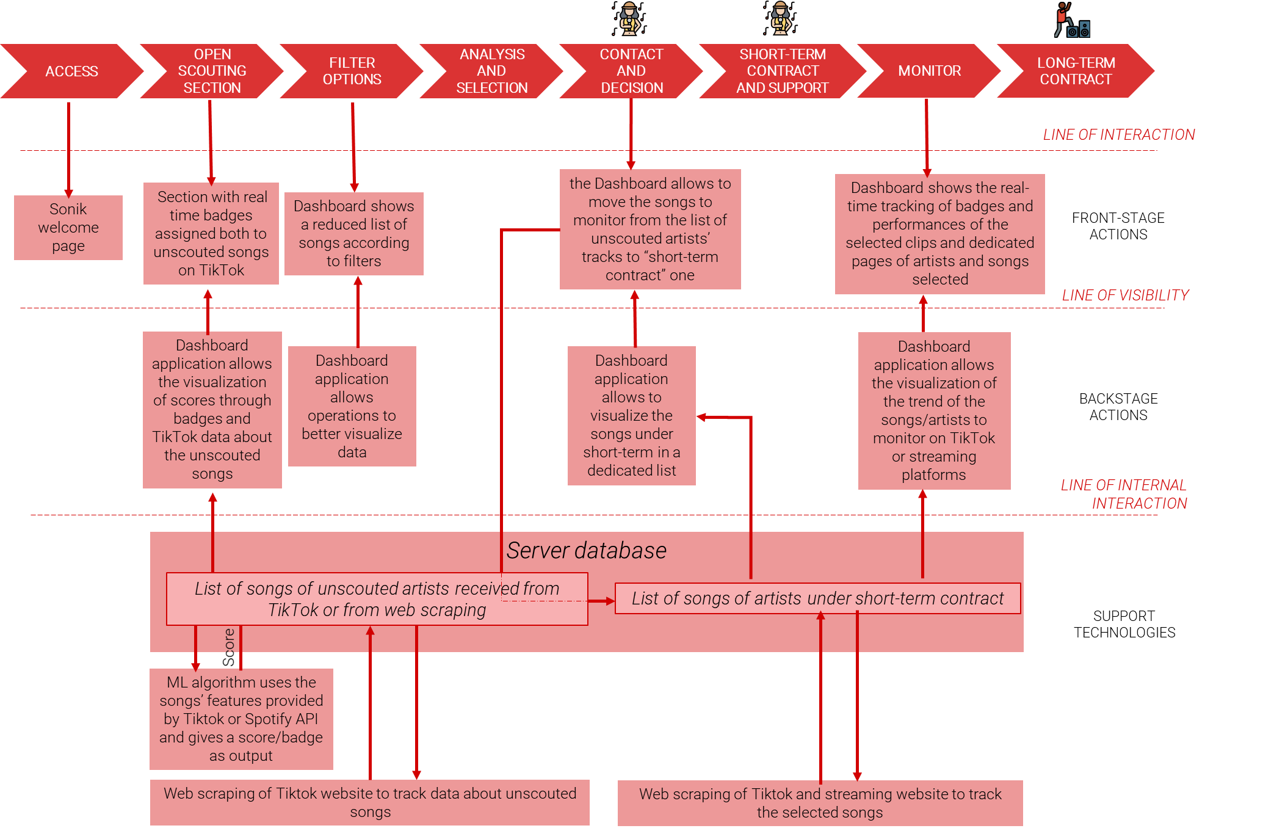
A&R Service Blueprint
13

Slide 28
Dashboard: Marketing Page
14

Slide 29
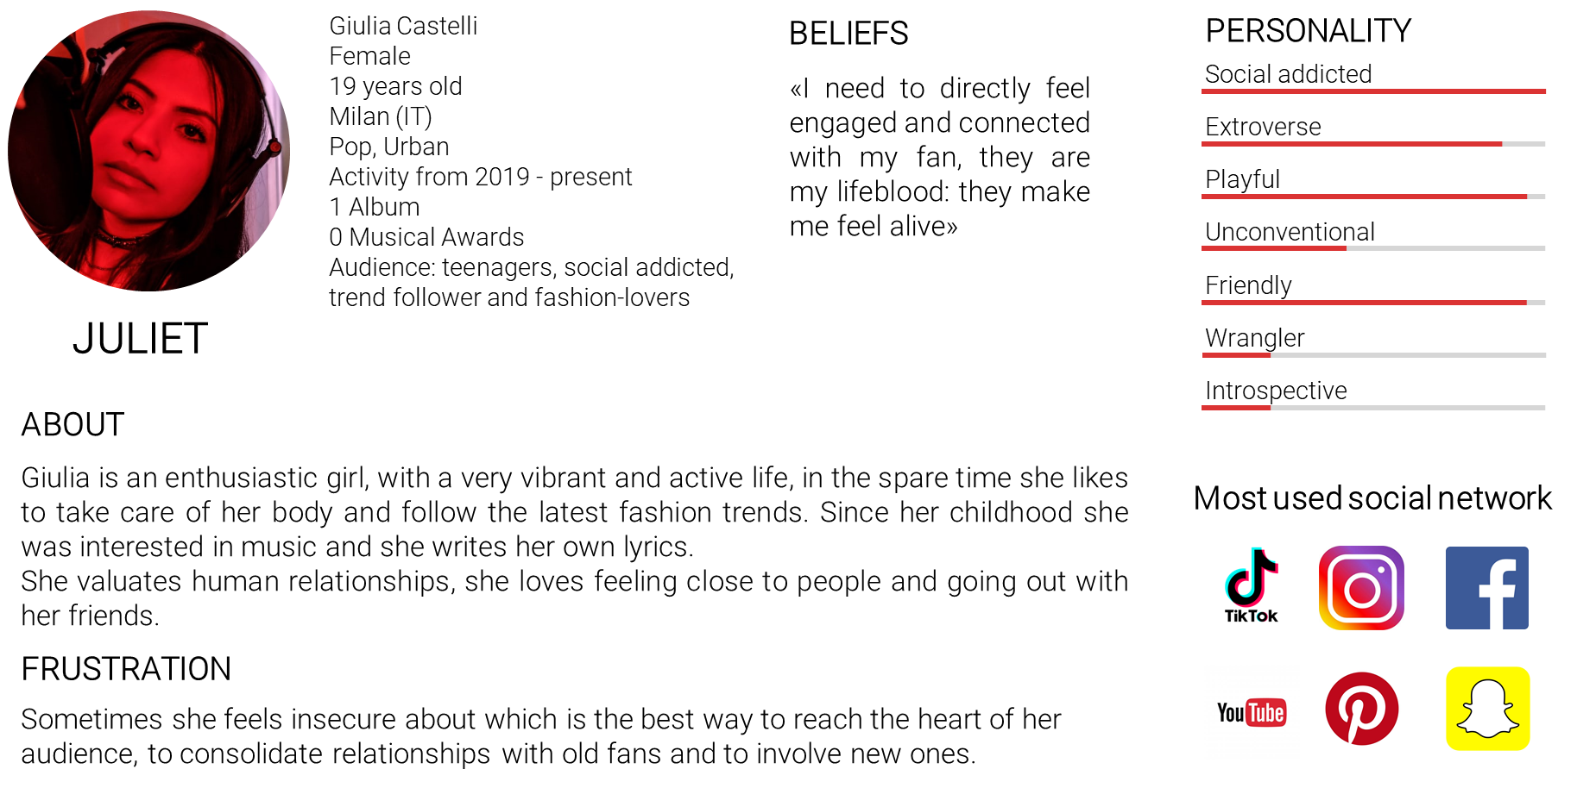
Marekting Framework: TikTok Friendly Artist
15

Slide 30
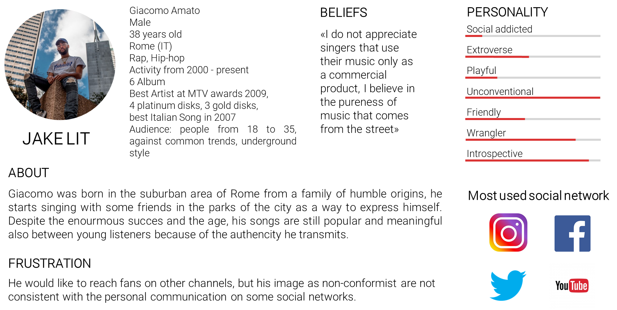
Marketing Framework: TikTok Distant Artist
16

Slide 31
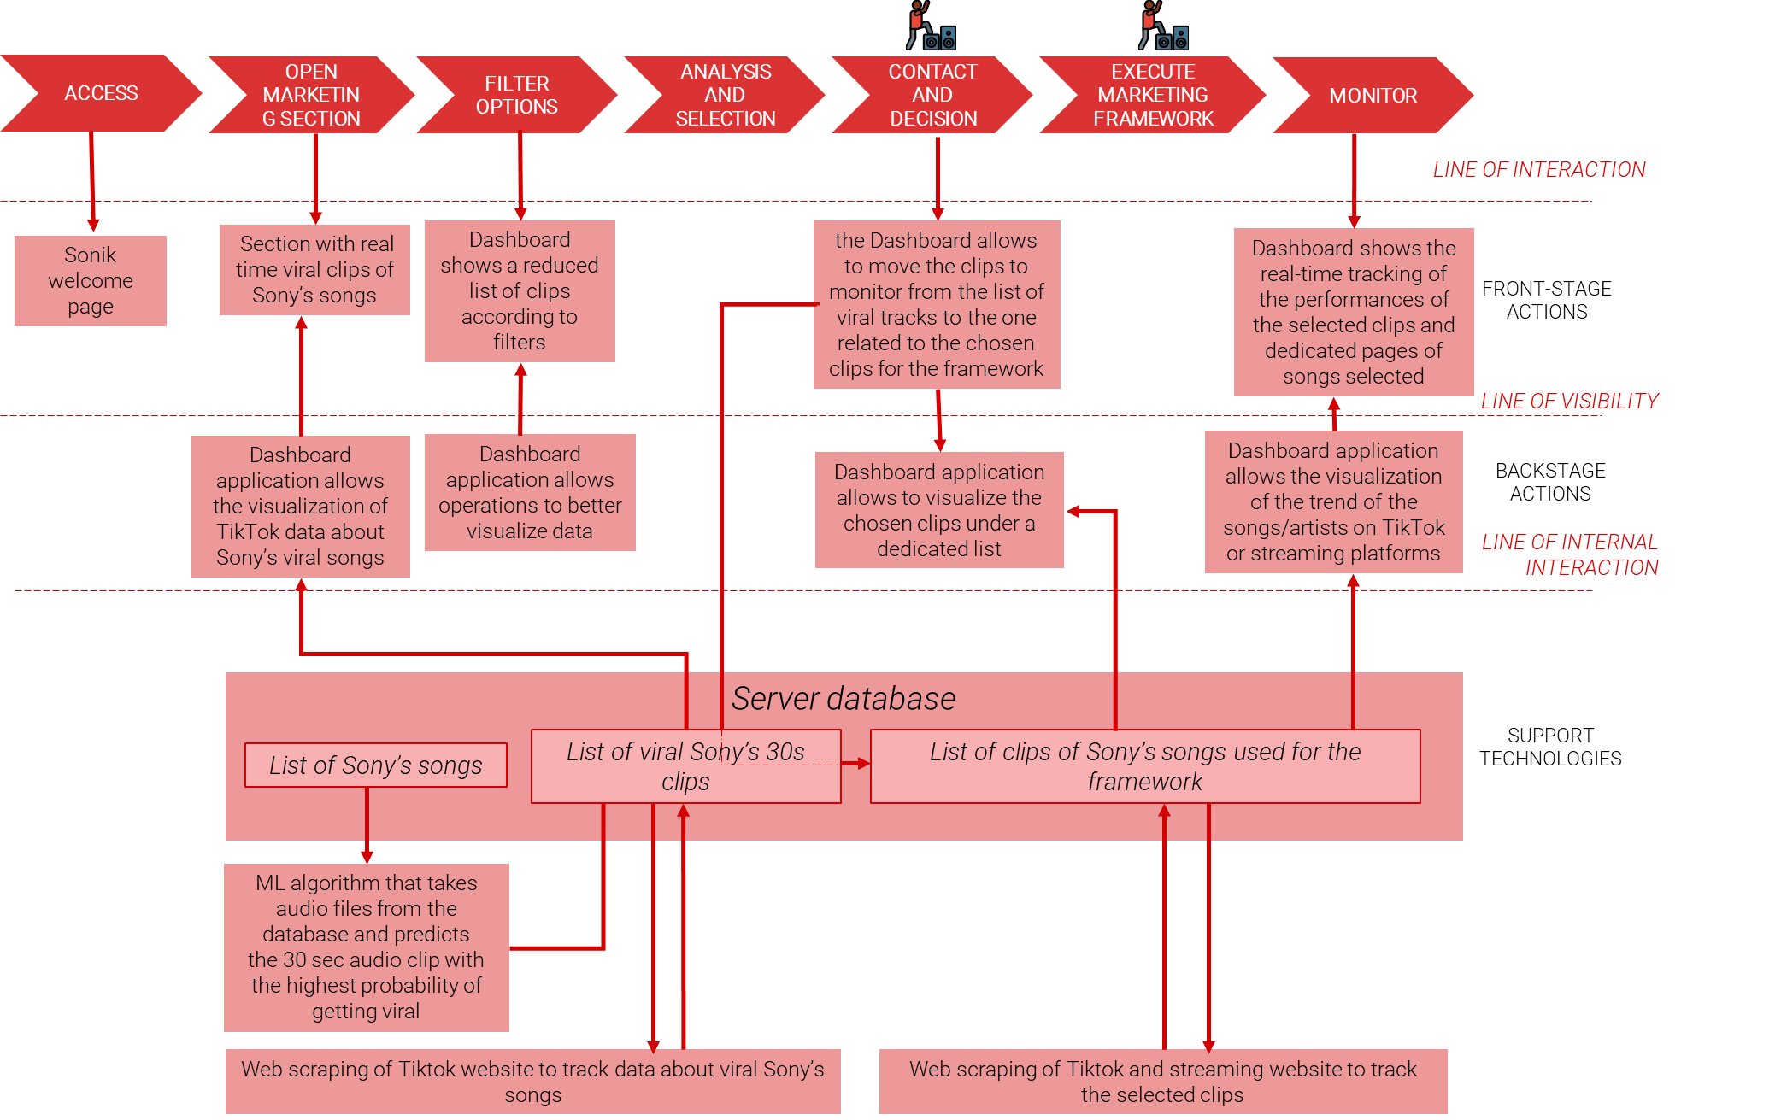
Marketing Service Blueprint
17

Slide 32
Key Metrics
18

Slide 33
Key Metrics
19

Slide 34
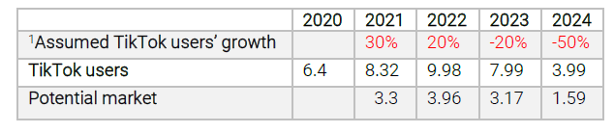
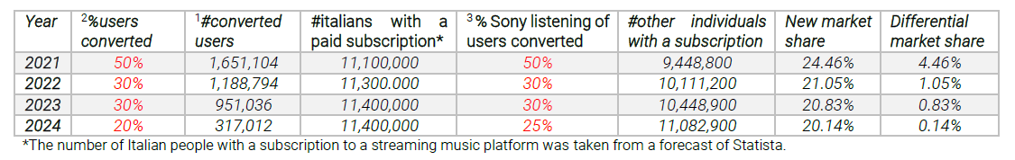
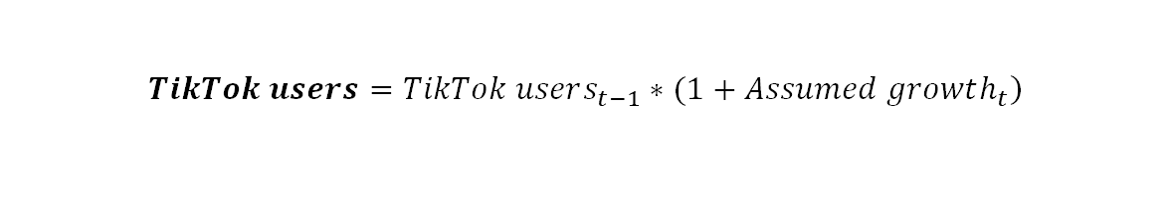
Economic Perspective: Revenues
$$\left.TikTok users=TikTok users_{t−1}∗(1+Assumed growth_{t}\right)$$
$$Potential market=TikTok users∗0,63∗0,63$$
$${\#TikTok users with a paid subscription converted}^{1}=Potential market∗{\%users converted}^{2}$$
USER CENTRIC REMUNERATION MODEL → distribution of subscription fee proportional to the listening of the single user
$$new market share= \frac{\# TikTok users with a paid subscription converted }{\#italians with a paid subscription}×{\%Sony listening of users converted}^{3}+$$
$$+ \frac{\left(\#italians with a paid subscription−\# TikTok users with a paid subscription converted\right)}{\#italians with a paid subscription}×20\%$$
20

Slide 35
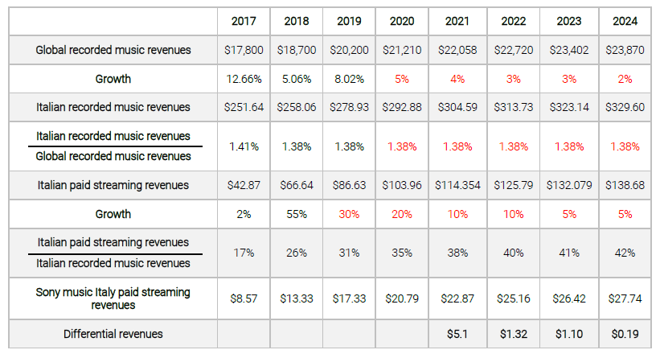
Economic Perspective: Revenues
21

Slide 36
Economic Perspective: Costs
COSTS
SUNK COSTS
Algorithm Development
PERIOD COSTS
FixedCosts
SAVING COSTS
Cost of Data
Research Costs
Variable Costs
Paid influencers' Costs
Infrastructural Costs
Dashboard Costs
22

Slide 37
Economic Perspective: Costs
 |  | Description | Assumptions | Single costs | Yearly cost
Sunk costs (algorithm development) |  | Cost of Data | 100k samples dataset Small in-house validation team of 1 or 2 people | Generation of a sample dataset: $ 70,000 | $ 72,500
 |  |  |  | In-house validation team: $2,500
 |  | Research costs | AI team of 5 members, 2 employees and 3 freelancers Lenght of the 2 projects: 1,5 months | Employees cost: $5,000 | $ 28,500
 |  |  |  | Freelancers cost: $ 3,000
Total cost |  |  |  |  | $ 101,000
Period costs | Fixed costs | Infrastructural costs |  | Cloud VM cost: 244.63 $/month | 718.14 $/month * 12 = $ 8,617.68
 |  |  |  | Flat File storage: 92,07 $/month
 |  |  |  | Database: 171,44 $/month
 |  |  |  | Dasboard infrastructure: 200 $/month
 |  | Dashboard costs | Microsoft Power BI cost ranges from $10 to $52. Maximum price considered 100 employees working in Sony Music Italy, 30% of them use the Dashboard |  | 52$/(users*month) * 30 * 12 = $ 18,720
 | Variable costs | Paid influencers costs | Remuneration of an influencer in Italy ranges from 300 to 600 €. Maximum price considered in dollars. 20 challenges out of 50 are assigned to paid influencers |  | 638 $/(challenge*month) * 20 * 12 = $ 153,120
Total cost |  |  |  |  | $ 180,457,68
23

Slide 38
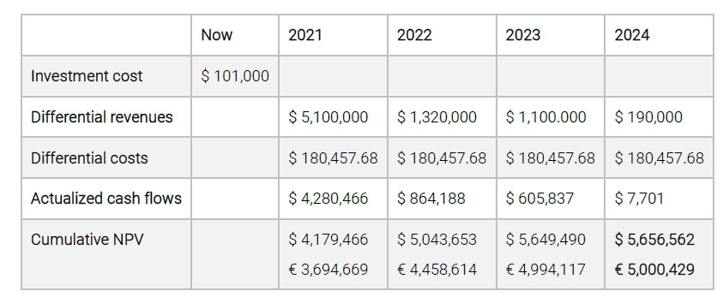
Economic Perspective: NPV
24

Slide 39
Business Model Canvas
25

Slide 40
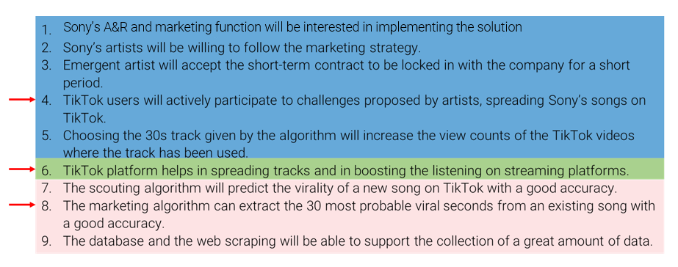
List of Hypothesis
26

Slide 41
Link to the survey
Questions link → https://www.shorturl.at/deCX2
Answers link → https://www.shorturl.at/fitPW
27

Slide 42
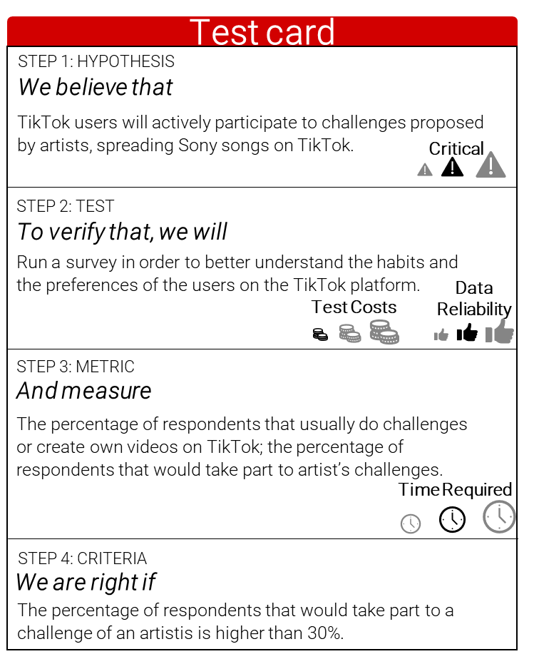
First Test Card
28

Slide 43
Survey’s Results
29

Slide 44
Survey’s Results
42%
26%
53%
9%
47%
23%
Users that would not like to take challenges proposed by artists
Users that take challenges and publish contents on TikTok
Users that would like to take challenges proposed by artists
Users that take challenges and don’t publish contents on TikTok
Users that don’t take challenges and publish contents on TikTok
Users that don’t take challenges and don’t publish contents on TikTok
30

Slide 45
Survey’s Results
Percentage of people that add TikTok songs to their playlist with the relative frequencies.
Most used streaming platforms.
Percentage of people that discover new songs on TikTok with the relative frequencies.
31

Slide 46
Survey’s Results
50 viral global
50 top global
50 viral Italy
50 top Italy
70%
84%
46%
52%
32

Slide 47
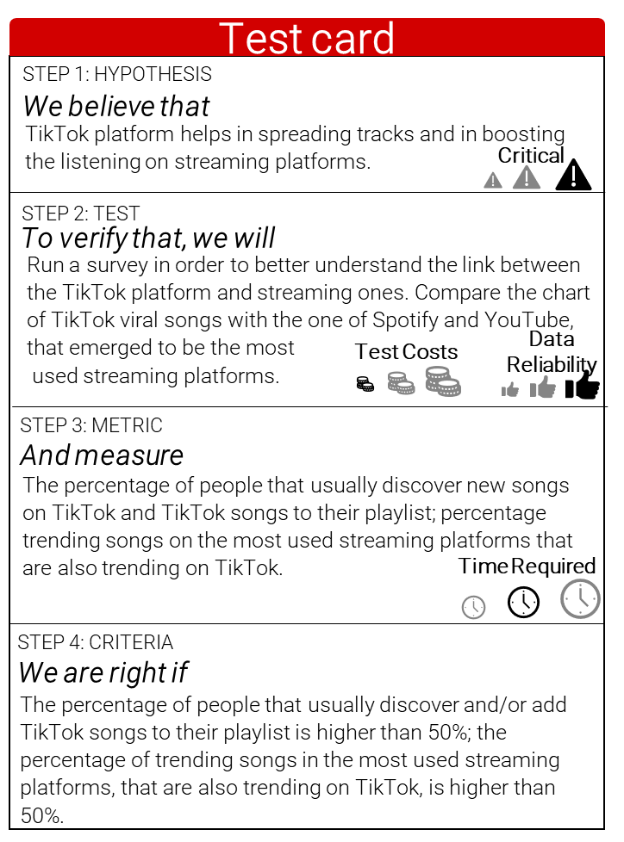
Second Test Card
33

Slide 48
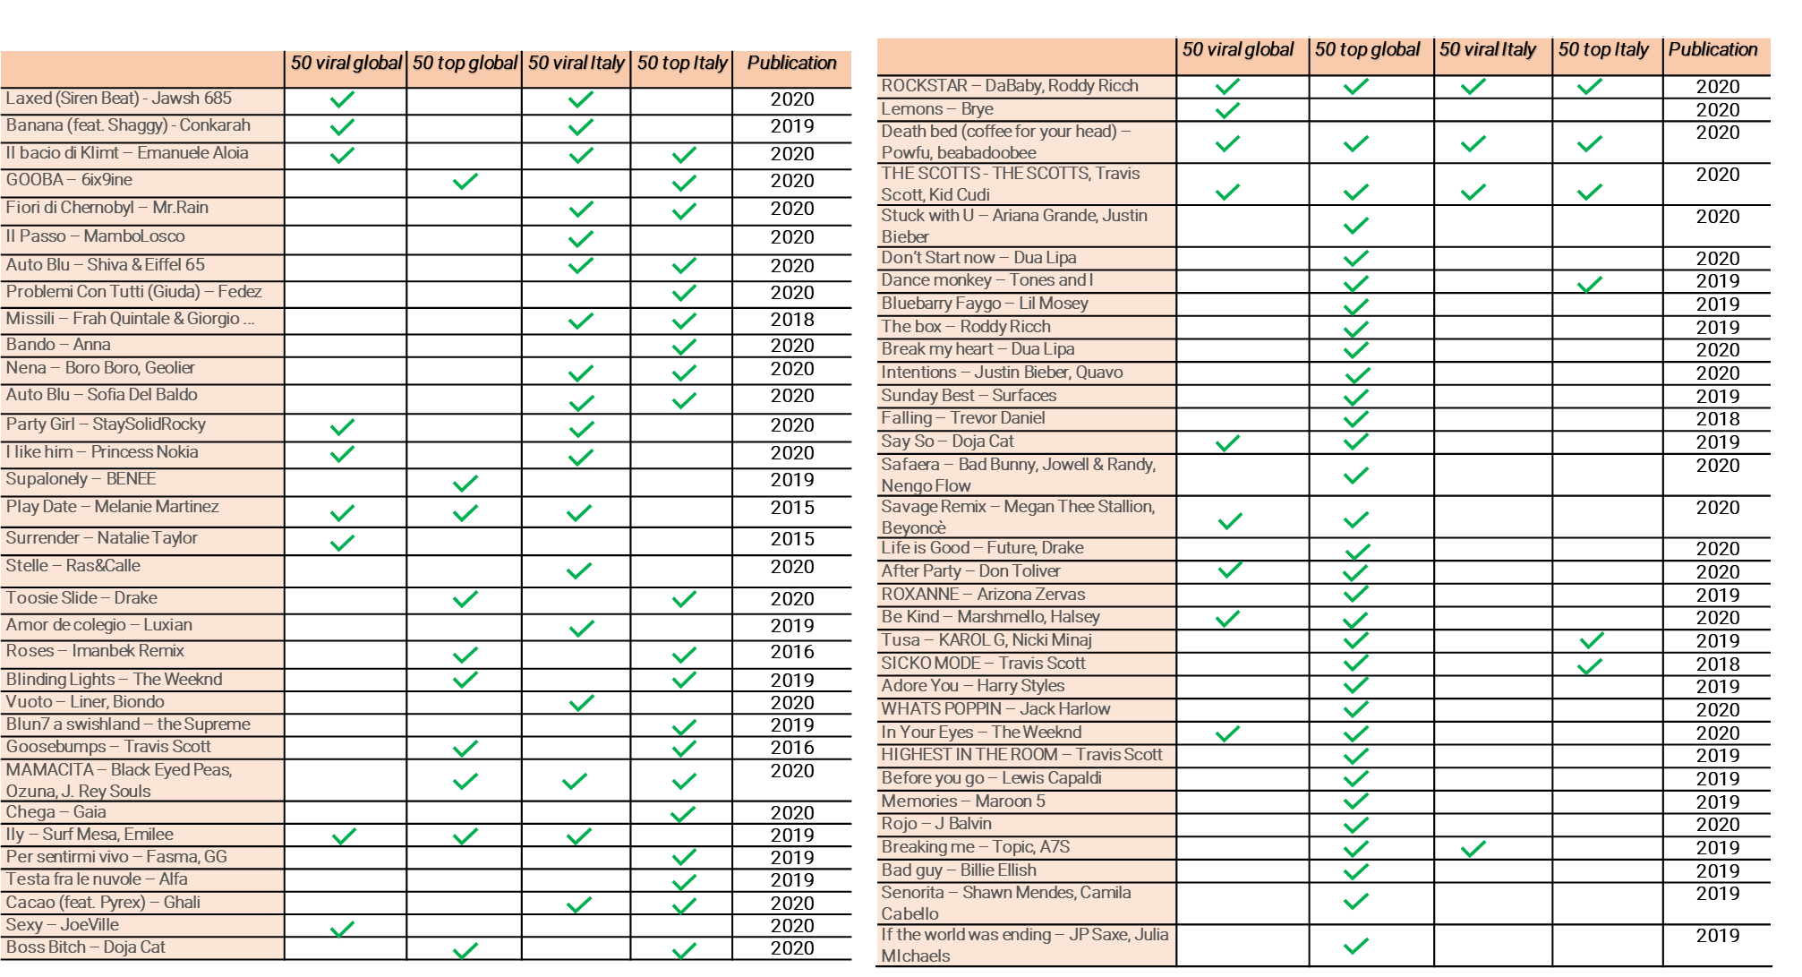
Spotify Tables
34

Slide 49
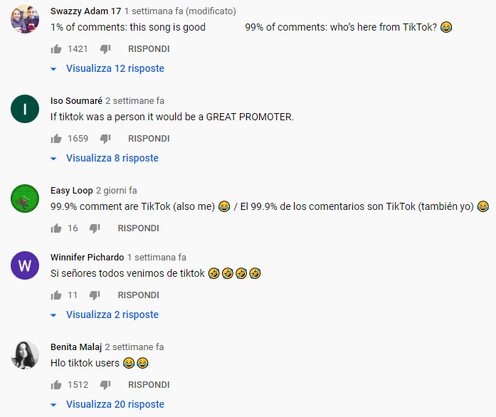
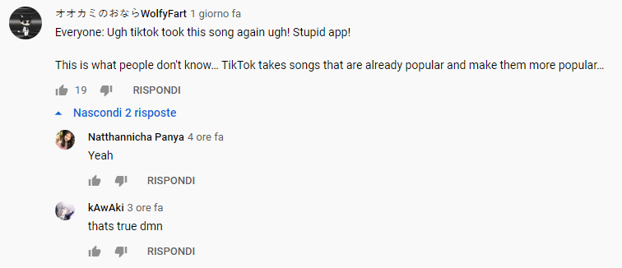
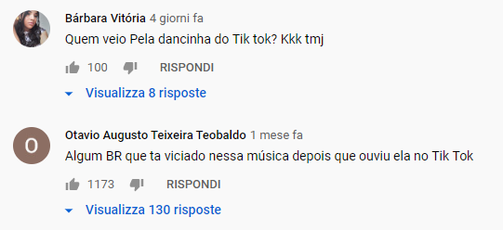
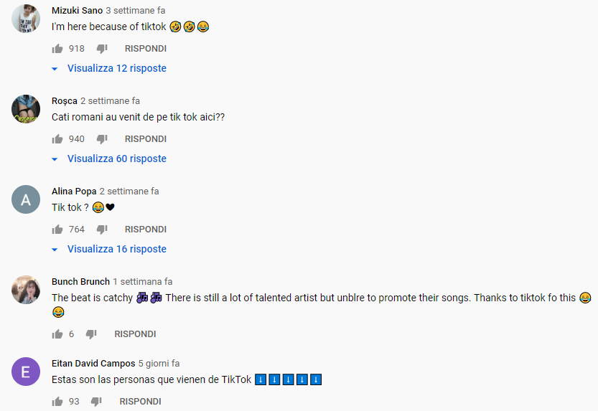
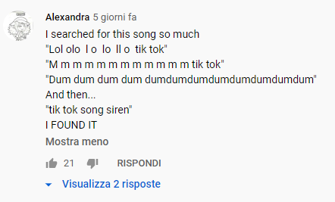
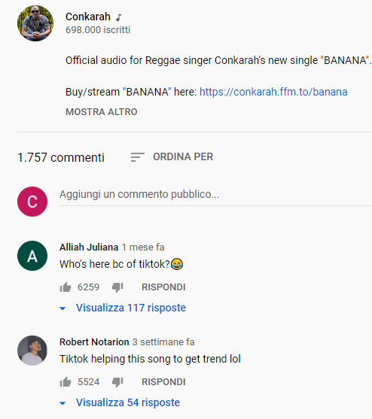
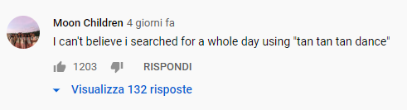
YouTube comments
35

Slide 50
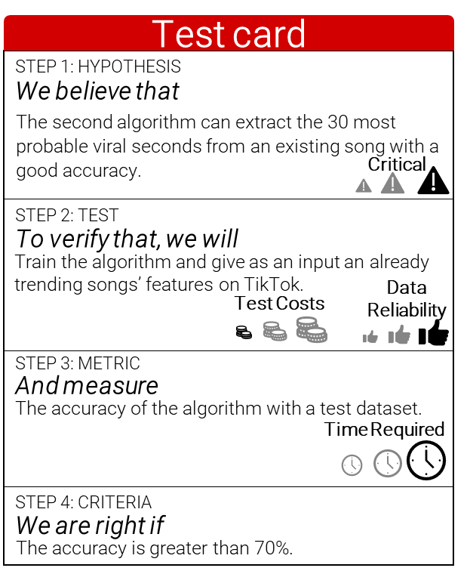
Third Test Card
36

Slide 51
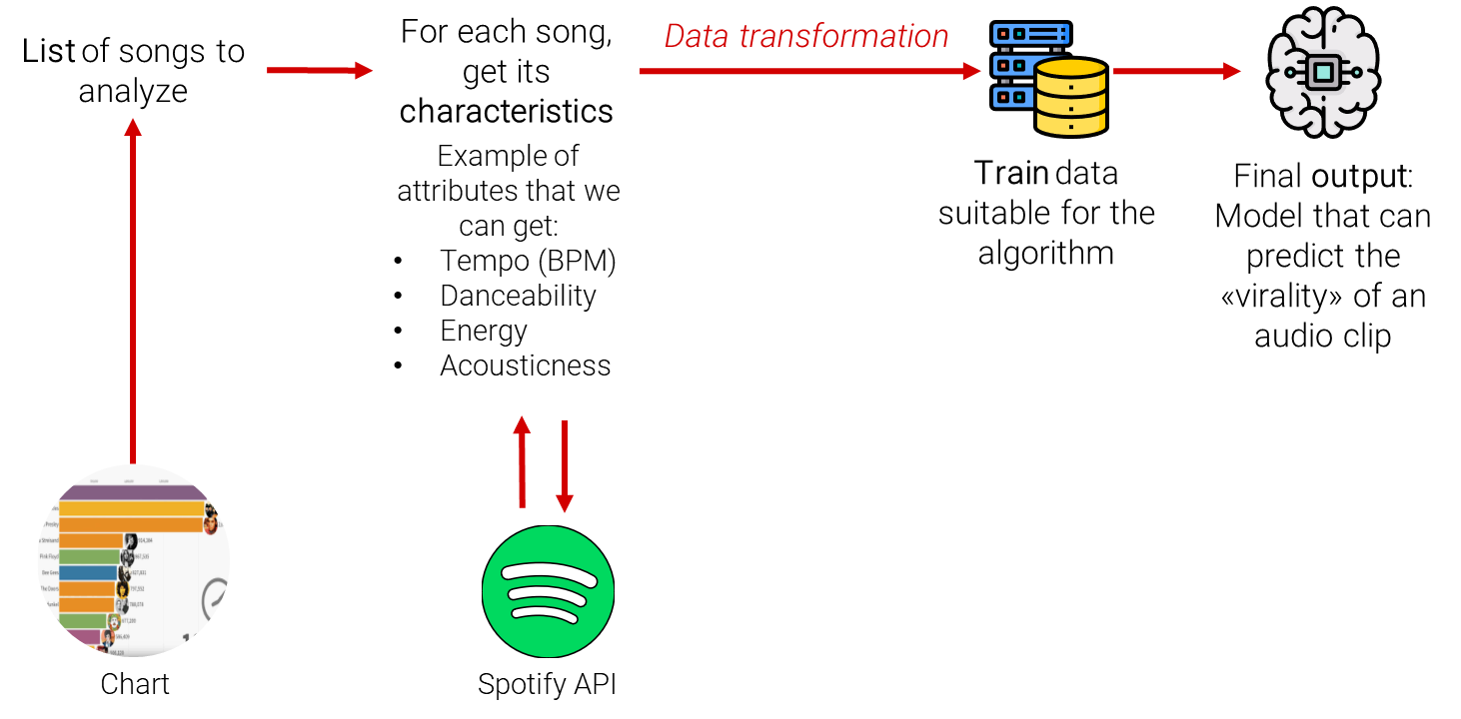
Building the model
37

Slide 52
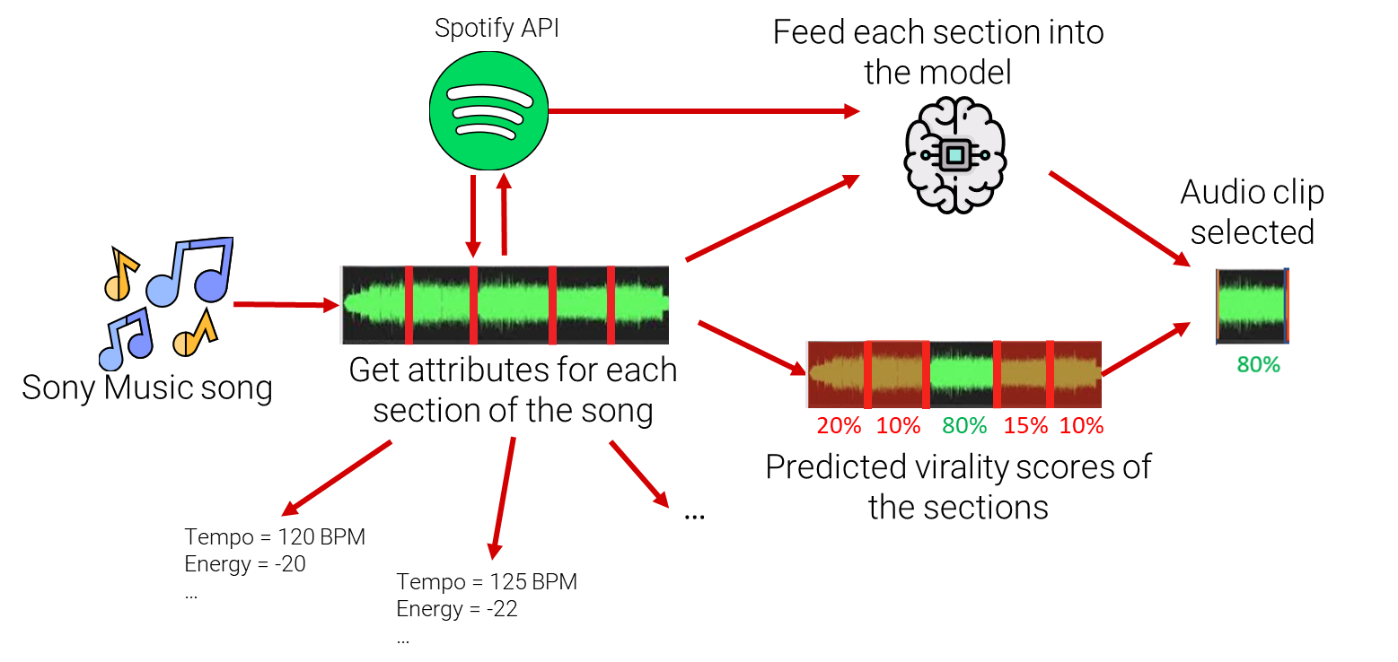
Technicalities
38

Slide 53
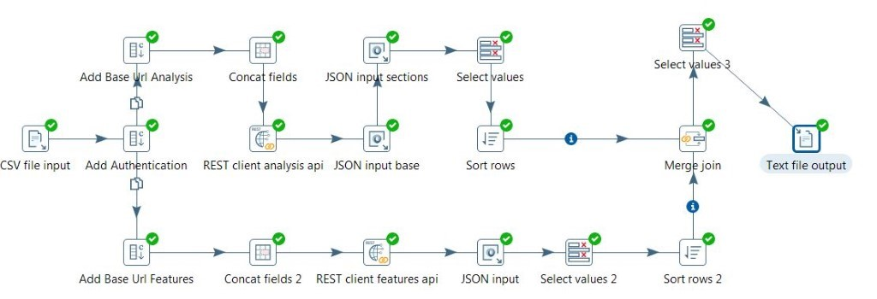
Technicalities
ETL Jobs for Data Preparation in Pentaho
39

Slide 54
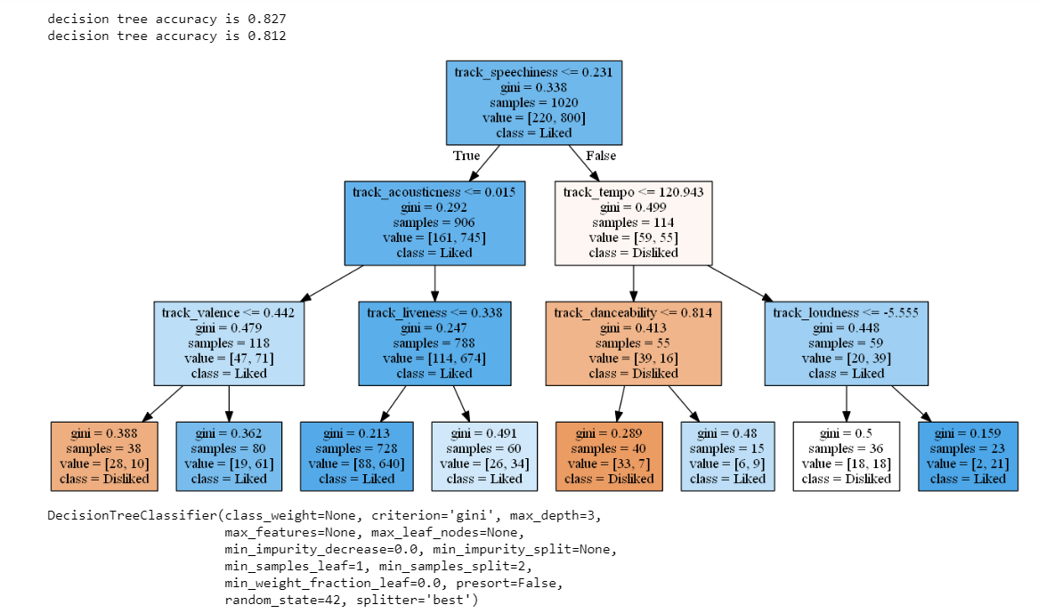
Technicalities
Decision Tree Model with Depth
40

Slide 55
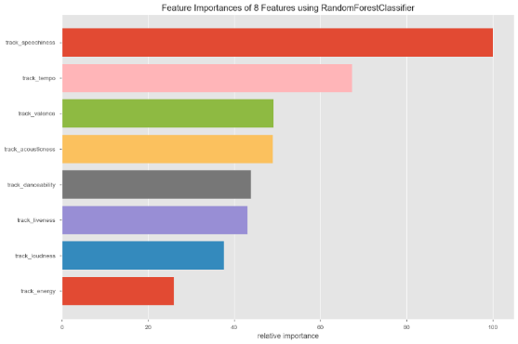
Technicalities
Feature Importance based on the Model
41

Slide 56
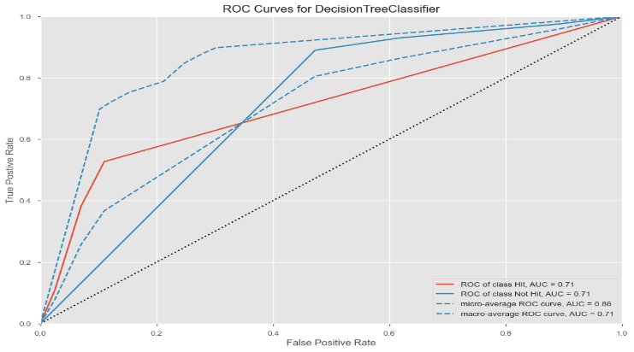
Technicalities
Accuracy Graph
42

Slide 57
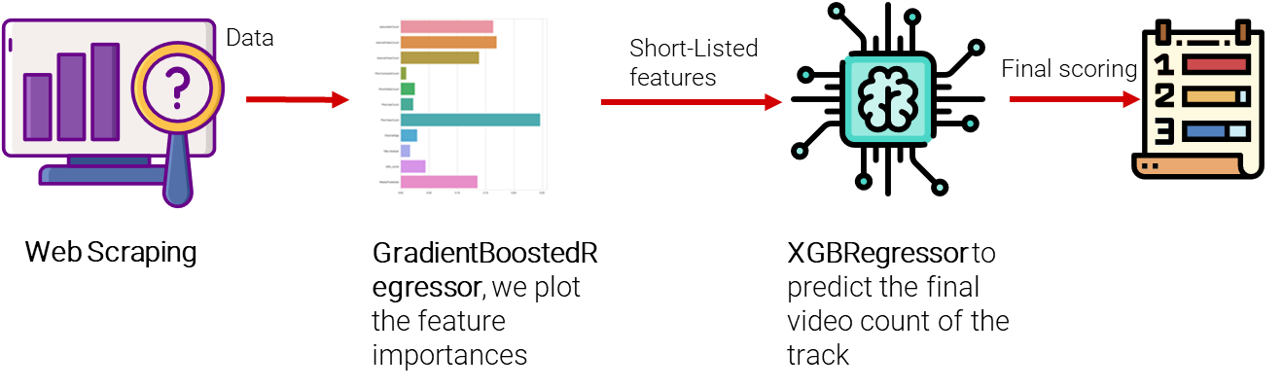
Idea behind the scouting algorithm
43

